Slide 1
Git Branching Strategy

Slide 2
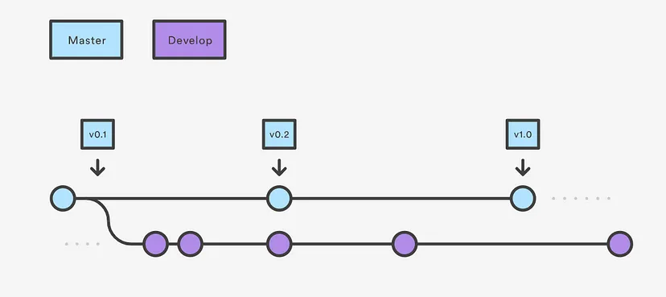
Develop and master branches

Slide 3



Create a develop branch for your initial implementation
Have your initial changes made and the code pushed into the develop branch and merged to the master branch.
Develop branch would keep the history of the project and the master the abridged version.
Master branch and develop branch have to have the same code before development.
Master branch stores the release history and the develop branch as for the integration of features.
Once features are integrated we merge the develop branch to our master branch.

Slide 4
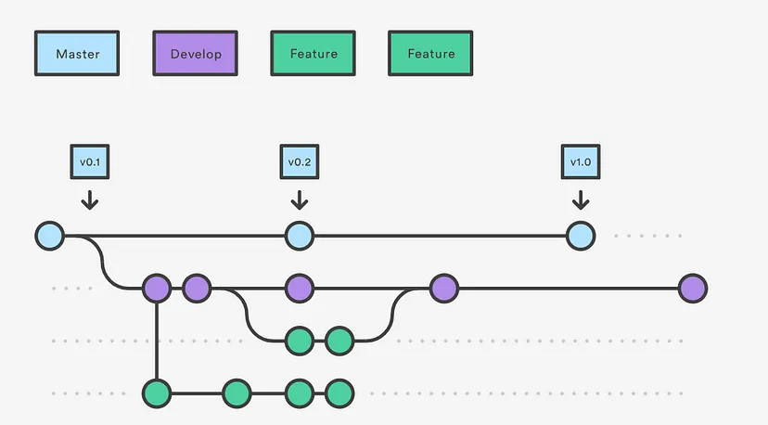
Feature Branches

Slide 5
Each feature has to have its own branch.
Feature branch branched from the develop branch and merged into develop once the feature has been implemented.
Provide meaningful names for your feature branches so that it’s visible what feature is implemented in the relevant feature branch.

Slide 6
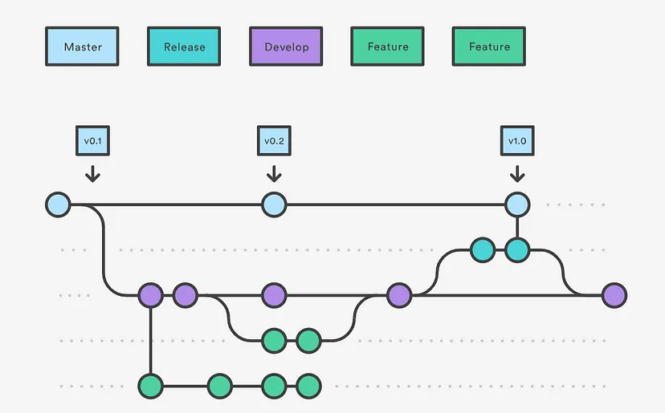
Release Tag

Slide 7
Once the features are ready for a release, we can create a release tag from the develop.
Creating this tag starts the next release cycle, new features cannot be added to the following release other than bug fixes or change in documentation.
Once we are ready to deploy we merge the release tag to master version using semantic versioning.

Slide 8
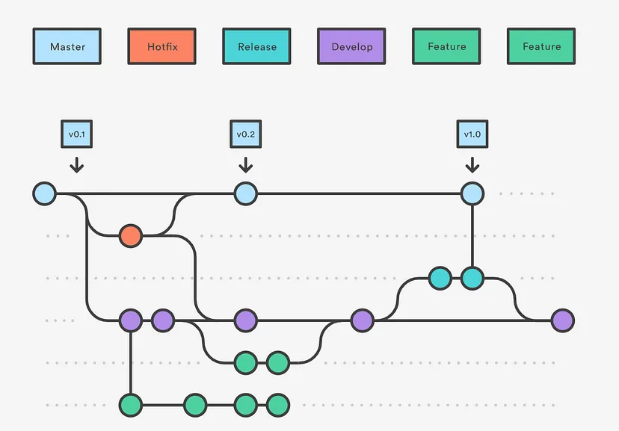
Hotfix Branches

Slide 9
Hotfix branches are created for immediate bug fixes to patch production releases.
These branches are forked from master, Not like release branches or feature branches which is forked from develop.
Once the fix is done this branch has to be merged into master and develop and the master should be tagged with an updated version number.

